Slide 1
Experiments in Economics Lecture 6
Analysing the data from the experiment

Slide 2
Analysing the data from the experiment
If you have organised the experimental software well, then the data will be in one or more Excel data files (or something similar).
There will be a row for each decision, and perhaps other rows giving more information (with data in the columns reminding you what is in the rows).
You will be able to analyse the data with a variety of softwares, depending upon what you want to do with it.
Softwares include Excel (if you must!), Stata, R, Maple, Matlab.

Slide 3
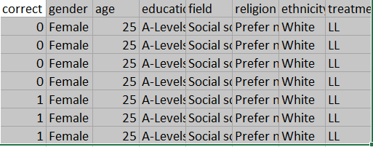
An example of part of a datafile From the experiment which did not collect all relevant data.

Slide 4
Analysing the data from the experiment
This very much depends upon what the objective of the experiment is.
In lecture 1 I mentioned the following types of experiment:
Observing – just seeing what happens
Testing the assumptions
Testing the conclusions
Estimating – fitting models to data, and getting estimates of key parameters.
Predicting
How you should analyse the data depends on the objective.

Slide 5
Observing – just seeing what happens
You just need to report the data in tables and/or figures.
Some summary statistics would be useful.
For example, if you wanted to see if women behave differently from men, and you were measuring their risk attitude, you should have a summary stating the mean risk-aversion for men and that for women.
You could report a simple mean, a standard deviation or a histogram.
What is crucial is that it gives a clear and unbiased portrayal of your main findings.
You could standard significance tests as to whether onemean is equal to some other mean.

Slide 6
A note on significance tests
These are purely statistical, the results of which depend upon the number of observations that you have and the amount of noise in the data.
An insignificant test does not tell you that there is no difference (between the means), only that you do not have enough data and there is too much noise.
A significant test tells you a lot more.
I would prefer you to look at economic importance rather than statistical significance.

Slide 7
Testing the assumptions
The assumptions will almost certainly be axioms
“All axioms are wrong”.
With individual data you can calculate the proportion of times a decision was taken which violated some axiom.
Testing whether this is significantly different from zero is pointless.

Slide 8
Testing the conclusions

Slide 9
Estimation

Slide 10
Prediction

